Slide 1


COR
Julia Eisner
TC McCaffrey
Jeffrey Hudak

Slide 2

What is COR?
A smarter, more modern way to stay healthy and train with your community.
COR is a mobile app that incorporates your personal health statistic data and gives users customized health and training recommendations.
COR encourages collaboration within your community by offering events and messaging platforms so like-minded people can meet up and enjoy wellness activities together.

Slide 3
System Overview
FITNESS APP
We will be using a 3 Tiered Architecture to implement COR.
This will be comprised of a client layer, service layer, and a database layer.
The architecture allows the user to interact with the system while allowing for data storage on the backend.

Slide 4
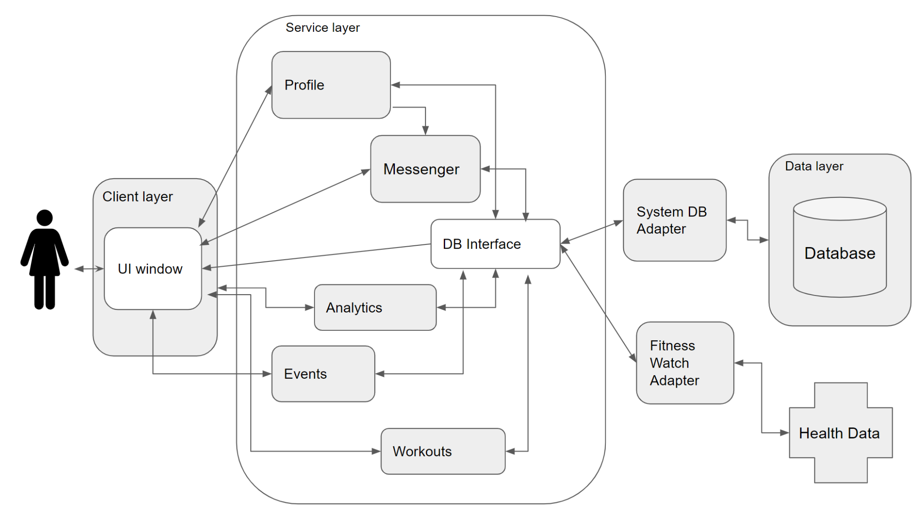
System Diagram
System Components
Client layer: the user interface; creating events, messaging other users, and taking on your next workout begins here.
Service layer: is the functionality of app itself; the heavy lifting done behind the buttons built largely using Node.js to send and pull everything necessary from the databases to the client.
Data layer: the database that stores everything necessary about our user’s such as personal health data, created events, etc.
Notes:
Client layer: UI Window which goes straight into central service layer
Service layer: profiles saved and created, analytics generated, where you view and create workouts and events
Database : in order to communicate between our database and our service layer we have a db adapter and

Slide 5
Actors
New Users
Platform Server
Registered Users
Fitness Watch Server
Users who have not yet created a COR account.
Firebase includes a built-in cloud database and authentication for housing data.
Users that have an existing COR account.
The user’s fitness watch will be used to draw health data and statistics.

Slide 6

Design Patterns
Adapters:
An adapter class will be used to connect the service and database layers.
Separate adapters will be used by the database and the fitness watch, with the adapter allowing for compatibility with different watches.

Slide 7


NODE.JS
FIREBASE DB
We plan to use the Node.js framework due to the large amount of resources found online to aid us in front-end and database translation development
FirebaseDB will be essential in making a secure, rapidly-updated, user-driven experience to provide a constant flow of new events to our users

Slide 8

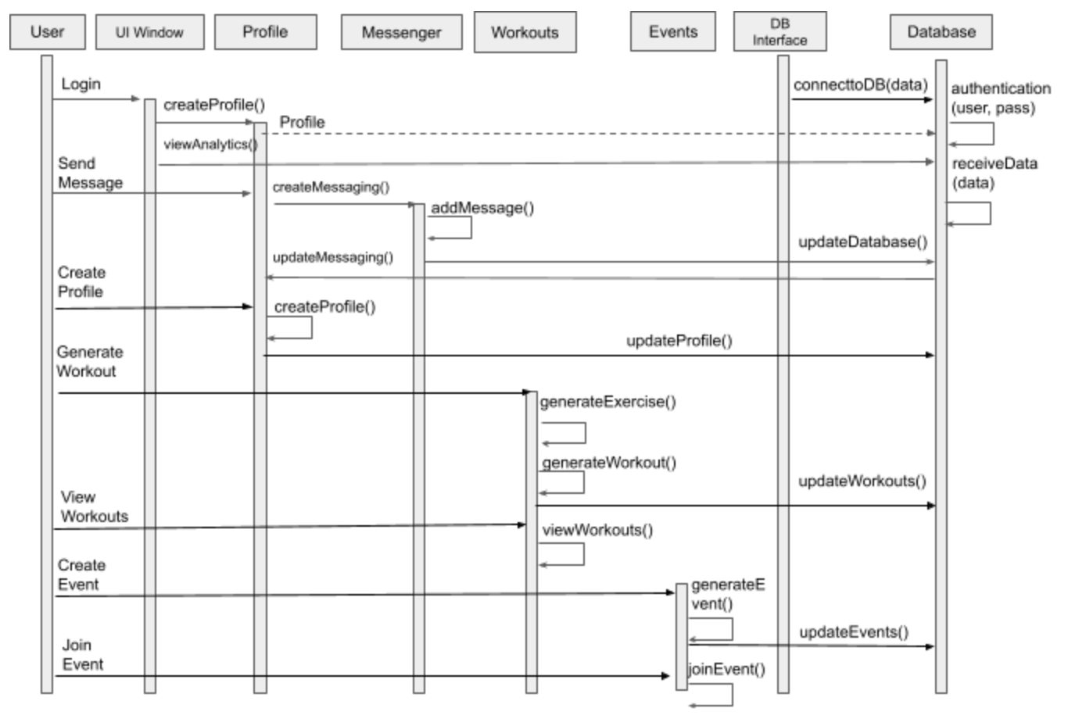
Sequence Diagram

Slide 9
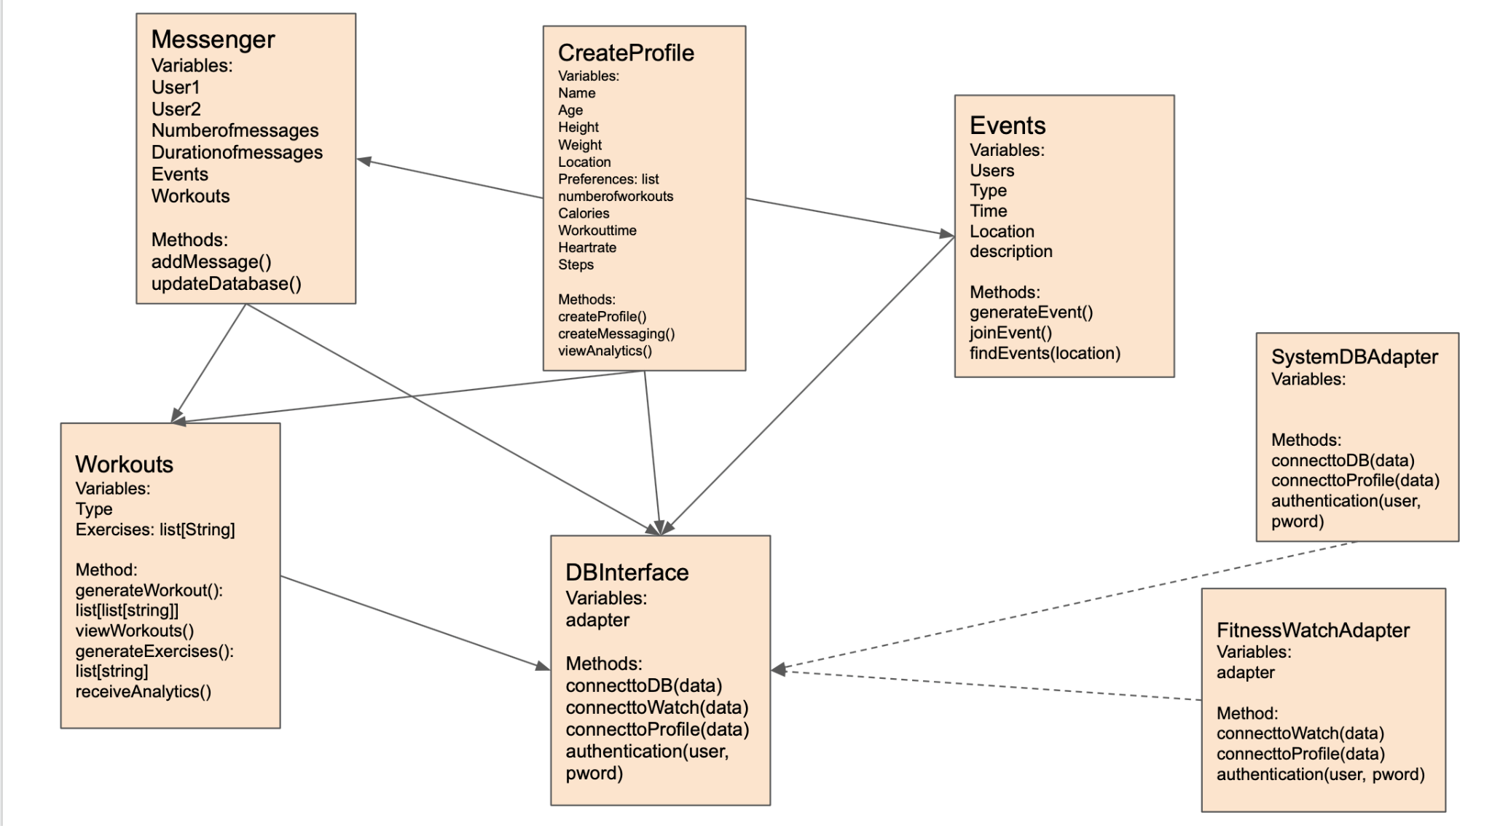
Class Diagram

Slide 10
EXPERIENCE
COR
Documentation can be found here: https://github.com/scrummasterjules/CSC431_Team13

